Slide 1
CS 101 Introduction to Computing
Semester – 2014 -15 / II Semester
Units – 2 – 0 – 2 – 3
Pre-requisite – None
Instructors – Sanjay Dhande, Arya Bhattacharyya, Lilian Besson, Vipin K
Tutors – Arya, Lilian, Vipin, Vivek, Kondiah

Slide 2
Lecture # 3, Section 1, Slide # 3.1.1
Different Types of Computers and Connectivity
Tablets, Laptop Notebook Computers
Personal Computers
Workstation Computers
Mainframe Enterprise Computers
Supercomputers
ETHERNET – local area networks
Wi-Fi – Wireless area network
Wide Area Network

Slide 3
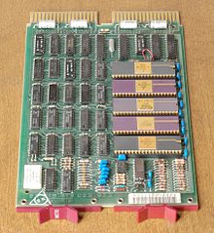
Lecture # 3, Section 1, Slide # 3.1.2
Structure of a Computer
Case
Power Supply
Motherboard
Expansion Slots
Storage devices and their controllers
Input / Output peripherals and their controllers
Computer Architecture
Computer Network

Slide 4
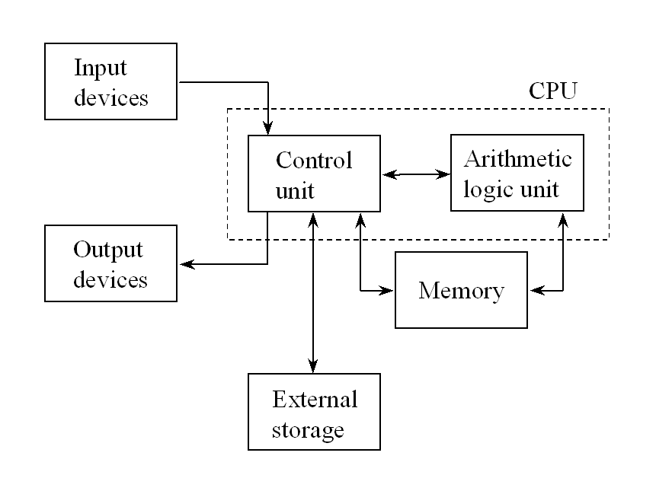
Lecture # 3, Section 1, Slide # 3.1.3
Basic Elements of a Computer

Slide 5
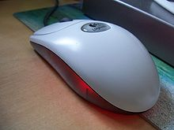
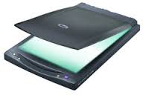
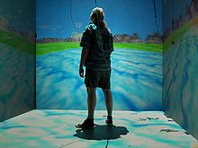
Lecture # 3, Section 1, Slide # 3.1.4
Different Input Devices
Light Pen
Joystick
Microphones
Joypad
Gamepad
Webcam
Digital Camera

Slide 6
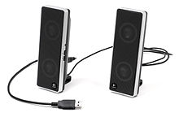
Lecture # 3, Section 1, Slide # 3.1.5
Different Output Devices
Projector
Plotter
Headphones
Television
Radio
Punched Cards
Line Printers
Braille Embosser
3-D Printer

Slide 7
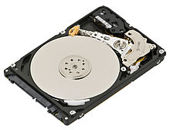
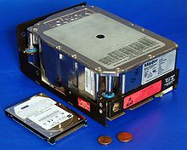
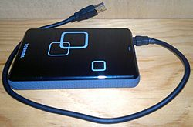
Lecture # 3, Section 1, Slide # 3.1.6
Different External Storage Devices
Magnetic Storage
Cassette Tapes
Floppy Disks
Optical Storage
Compact Disks (CD)
Digital Versatile
Disks (DVD)
Solid State Storage
Flash Memory
Microfilms
Disk Enclosures
Zip Disks
Punched Cards

Slide 8
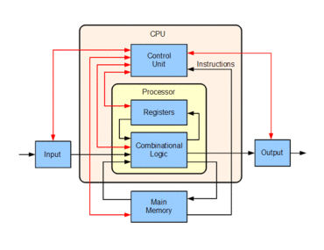
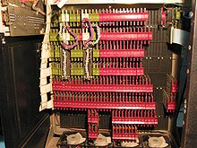
Lecture # 3, Section 1, Slide # 3.1.7
Central Processing Unit
CPU – Central
Processing Unit
ALU – Arithmetic
Logical Unit
Logical Unit
Basic Arithmetic Unit
Control Unit
I/O Control Unit

Slide 9
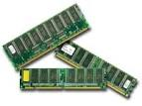
Lecture # 3, Section 1, Slide # 3.1.8
Memory
Memory Devices
IC, VLSI
Random Access Memory
Read Only Memory
Managing Memory

Slide 10
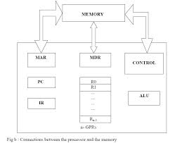
Lecture # 3, Section 1, Slide # 3.1.9
Connection Between Memory and Processor
IR – Instruction Register
PC – Program Counter
R0 … R (n-1)
General Purpose Registers
MAR –
Memory Address Register
MDR –
Memory Data Register
ALU
Arithmetic Logic Unit
CPU
Central Processing Unit

Slide 11
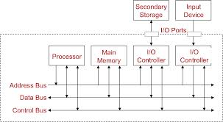
Lecture # 3, Section 1, Slide # 3.1.10
Bus Architecture

Slide 12
Lecture # 3, Section 2, Section 3.2.1
Concept of a Computer Program
High Level Programming
Source code
Syntactical and Logical Errors
Compilation and Execution
Input / Output data
Operating Systems
Compilers
Interpreters

Slide 13
Lecture # 3, Section 2, Slide # 3.2.3
Source Code Processing
Syntactical errors in source code
Language errors in source code
Compilation of source
Generate object code using a compiler
Execute the object code
Translate the line using an interpreter
Process the result immediately

Slide 14
Lecture # 3, Section 2, Slide # 3.2.4
Programming Languages
Interpretive Languages
LISP
Python
Compiling Languages
Fortran – 77
Pascal
C
Object-oriented Languages
Java

Slide 15
Lecture # 3, Section 2, Slide # 3.2.5
Program Execution
Run the program using data
Run time errors
Analysis of run time errors
Menu-driven program
Menu invokes a command
Command gets executed
Program is back to wait mode
Data is put in a file
Menu-driven data creates file

Slide 16
Lecture # 3, Section 2, Slide # 3.2.6
Operating Systems
Computer system software
DOS
Multi-window, Multi-process
Windows
UNIX
Coordination of all functions is carried out by the operating system
All applications run in OS domain

Slide 17
Thank You!
Visit us at www.mahindraecolecentrale.edu.in
Disclaimer
Mhindra, Ecole Centrale, herein referred to as MEC provide a wide array of presentations and reports, with the contributions of various professionals. These presentations and reports are for informational purposes and private circulation only and do not constitute an offer to buy or sell any securities mentioned therein. They do not purport to be a complete description of the markets conditions or developments referred to in the material. While utmost care has been taken in preparing the above, we claim no responsibility for their accuracy. We shall not be liable for any direct or indirect losses arising from the use thereof and the viewers are requested to use the information contained herein at their own risk. These presentations and reports should not be reproduced, re-circulated, published in any media, website or otherwise, in any form or manner, in part or as a whole, without the express consent in writing of MEC or its subsidiaries. Any unauthorized use, disclosure or public dissemination of information contained herein is prohibited. Unless specifically noted, MEC is not responsible for the content of these presentations and/or the opinions of the presenters. Individual situations and local practices and standards may vary, so viewers and others utilizing information contained within a presentation are free to adopt differing standards and approaches as they see fit. You may not repackage or sell the presentation. Products and names mentioned in materials or presentations are the property of their respective owners and the mention of them does not constitute an endorsement by MEC. Information contained in a presentation hosted or promoted by MEC is provided “as is” without warranty of any kind, either expressed or implied, including any warranty of merchantability or fitness for a particular purpose. MEC assumes no liability or responsibility for the contents of a presentation or the opinions expressed by the presenters. All expressions of opinion are subject to change without notice.
Copyright © 2012 Mahindra Satyam. All rights reserved.

