Slide 1
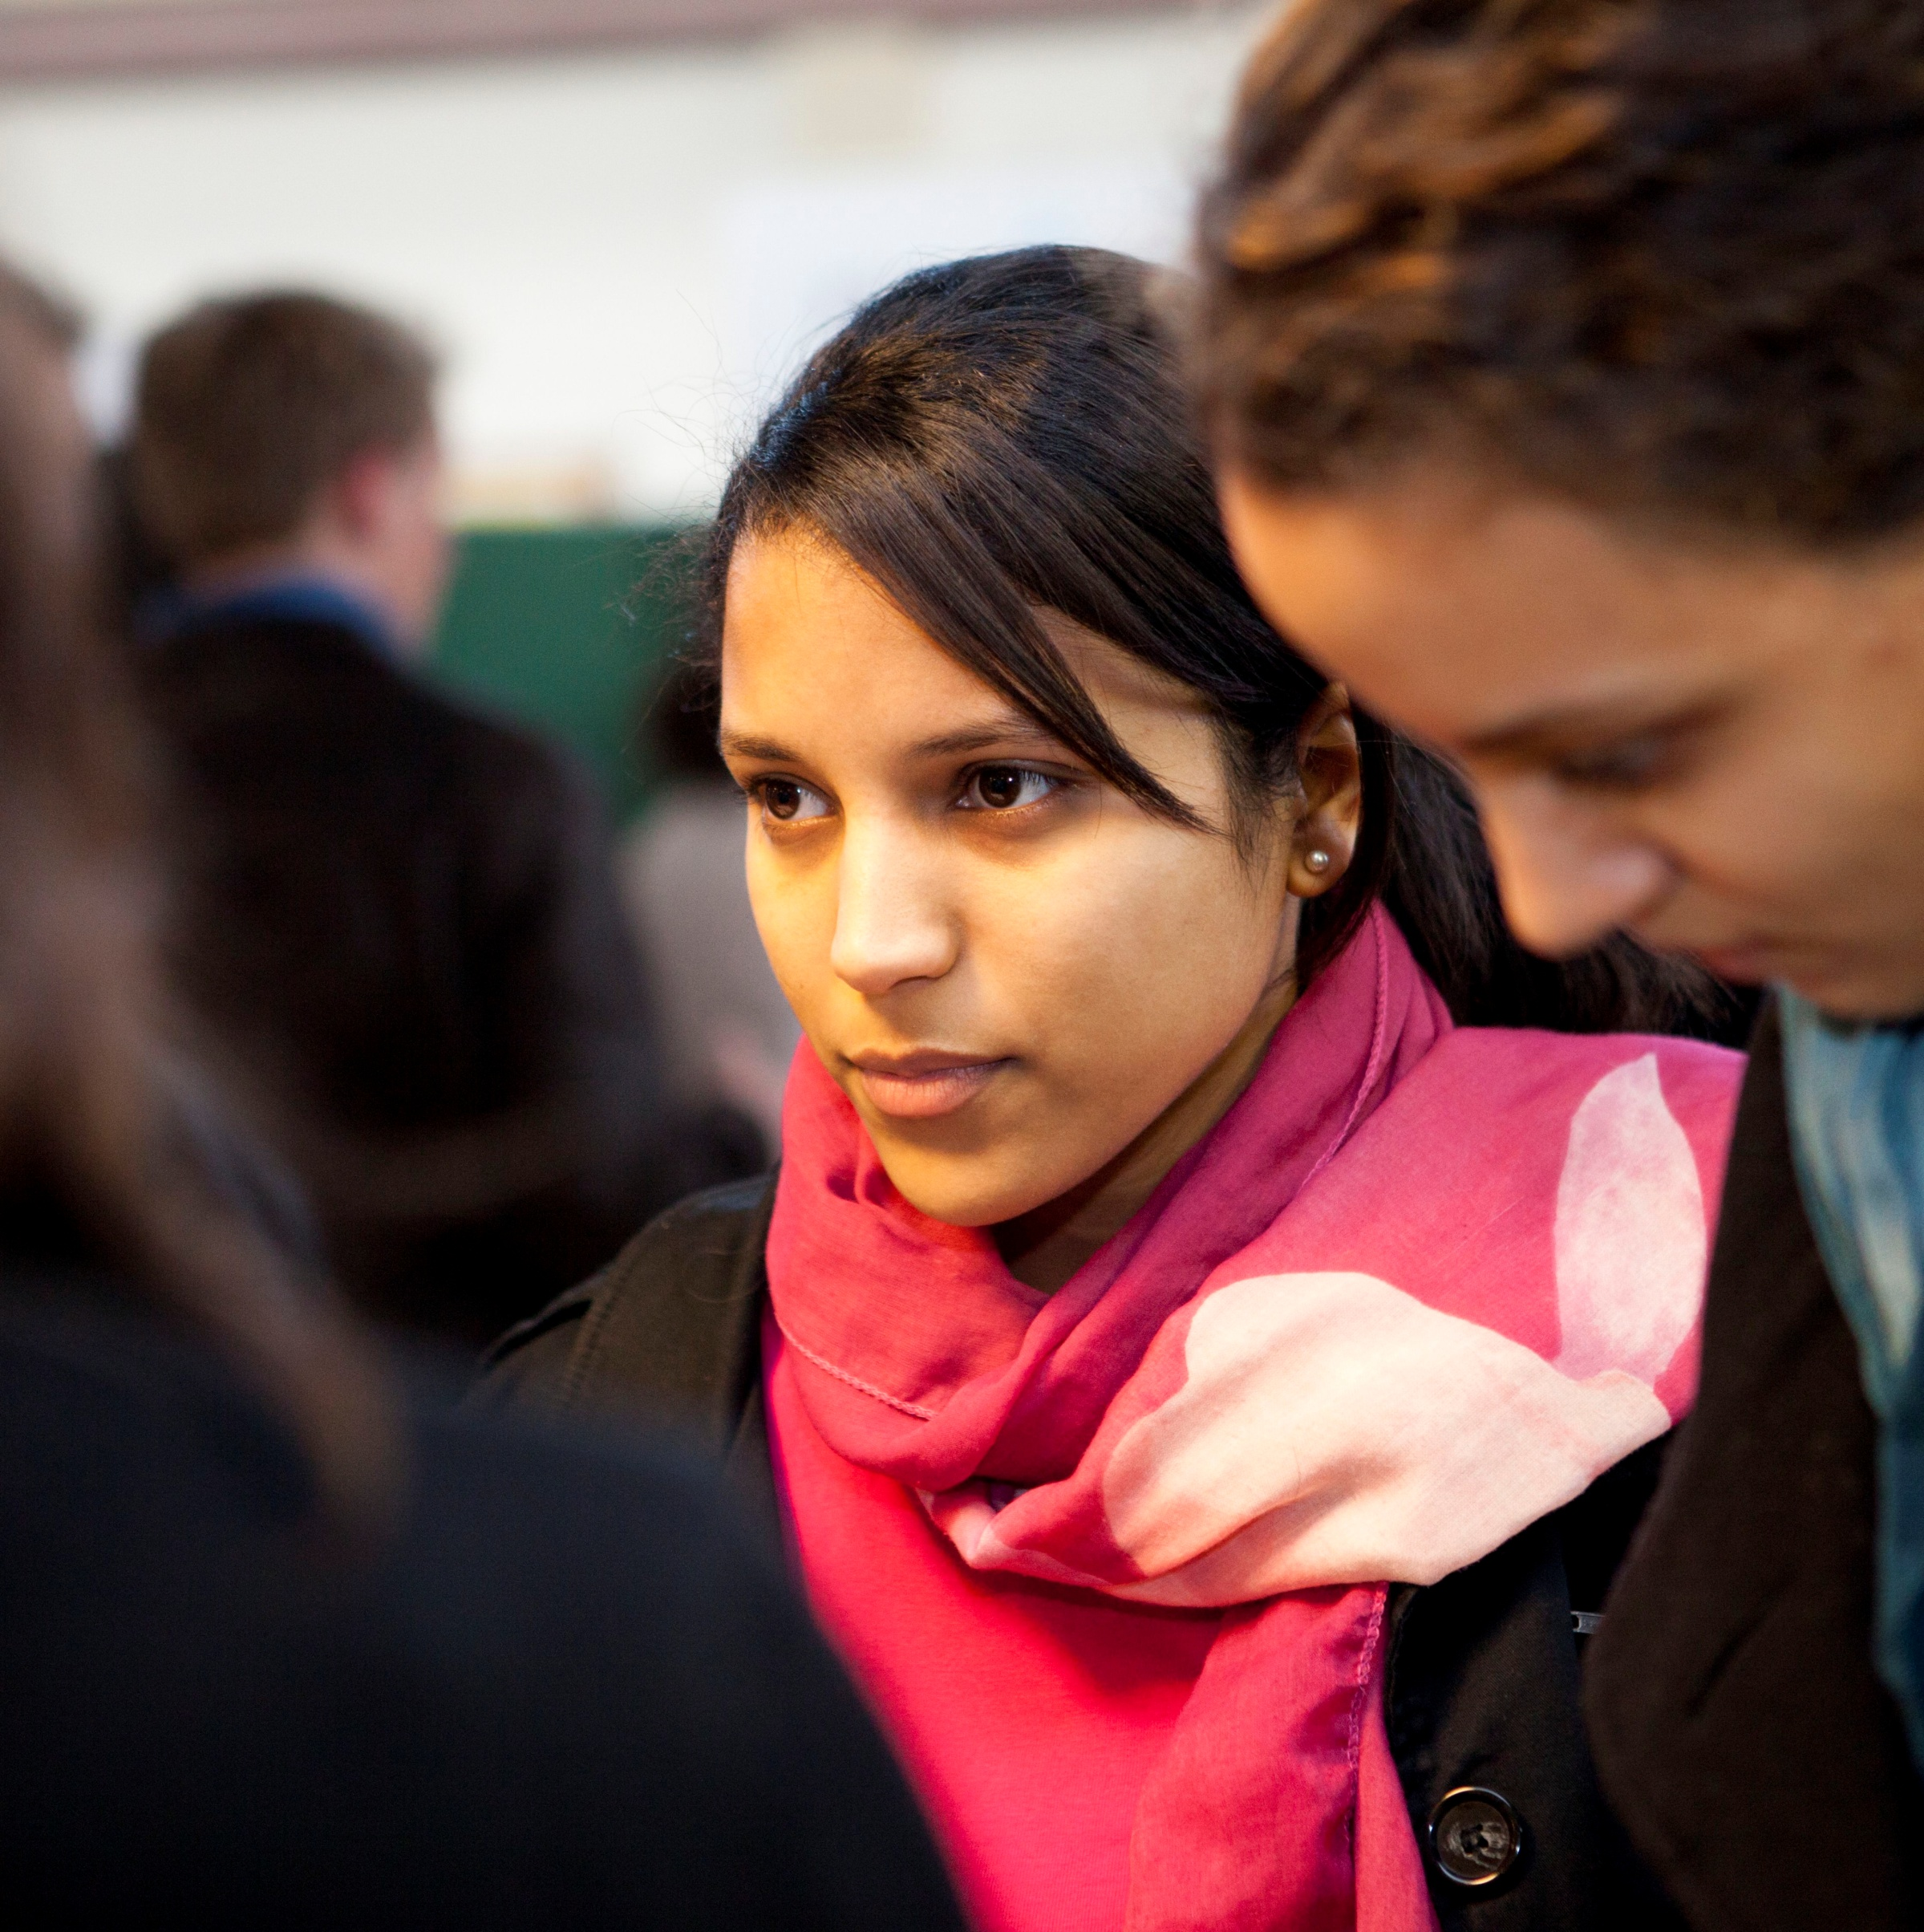
CS 101 Introduction to Computing
Semester – 2014 -15 / II Semester
Units – 2 – 0 – 2 – 3
Pre-requisite – None
Instructors – Sanjay Dhande, Arya Bhattacharyya, Lilian Besson, Vipin K
Tutors – Arya, Lilian, Vipin, Vivek, Kondiah

Slide 2
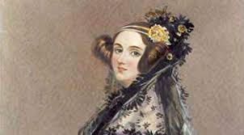
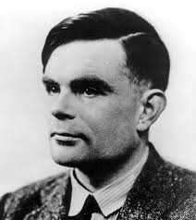
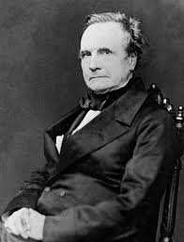
Lecture # 2, Section 1, Slide # 2.1.1
Pioneers of Computer Science

Slide 3
Lecture # 2, Section 1, Slide # 2.1.2
Contributions of Pioneers - I
A general purpose, programmable machine can be built – a computer
Any information which can be represented logically by symbols can be processed using programmable machines
A sequence of instructions can be developed to solve a problem
Whether a machine can think? – A I

Slide 4
Lecture # 2, Section 1, Slide # 2.1.3
Contributions of Pioneers - II
Turing Machine – Logical Computing Machine is a theoretical model of a consistent framework for a finite state machine
Hilbert, Goedel, and Von Neumann complimented the foundation laid out by Turing
Cryptographical algorithms were useful in illustrating the concepts

Slide 5
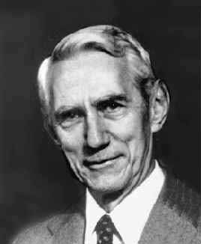
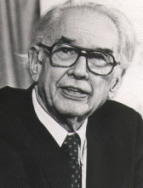
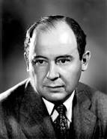
Lecture # 2, Section 1, Slide # 2.1.4
Pioneers of Computers

Slide 6
Lecture # 2, Section 1, Slide # 2.1.5
Contributions of Pioneers - III
Claude Shannon developed the Boolean operations and their equivalent electromechanical circuits
Von Neumann laid the foundation of design of the first major computer
John Atanasoff built a major computer using vacuum tubes and other electrical devices

Slide 7
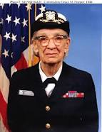
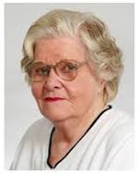
Lecture # 2, Section 1, Slide # 2.1.6
Pioneers of Computer Programming

Slide 8
Lecture # 2, Section 1, Slide # 2.1.7
Contributions of Pioneers - IV
Grace Hopper did the programming of Mark I computer at Harvard
Jean Jennings Bartik developed the concept of subroutines
Betty Snyder Holberton developed the concept of flowcharts and diagrams for writings the programs

Slide 9
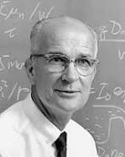
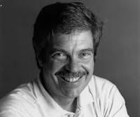
Lecture # 2, Section 1, Slide # 2.1.8
Pioneers of Computer Hardware

Slide 10
Lecture # 2, Section 1, Slide # 2.1.9
Contributions of Pioneers - V
William Shockley won the Nobel Prize for inventing the transistors
Doug Engelbert invented the mouse which has been a key input device besides the keyboard
Alan Kay built the first table-top computer at Xerox Park using the modern printed circuit boards and microchips

Slide 11
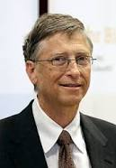
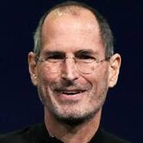
Lecture # 2, Section 1, Slide # 2.1.10
Pioneers of Personal Computers

Slide 12
Lecture # 2, Section 1, Slide # 2.1.9
Contributions of Pioneers - V
Steven Jobs invented the human machine interface with menus and icons
Steve Wazniak developed the man – machine hardware interface such as pen and associated software
Bill Gates developed the Windows software for PCs…..

Slide 13
Lecture # 2, Section 1, Slide # 2.1.10
Tipping Points of CS
Bits and Atoms – Discrete Nature
Information – Music, Graphics, Alphabets, Numerals, Symbols
Concept of Algorithm
Machine execution of algorithm
Data Structures
Data packets – Transmission, Distribution and Assembly
Central, Distributed, Mobile Computing

Slide 14
Lecture # 2, Section 2, Slide # 2.2.1
Strategies of Problem-solving
Divide and Conquer Approach
Iterative Methods
Recursive Technique
Hill Climbing Methods
Parallel Algorithms
Methods of Induction
Logical Reasoning Technique

Slide 15
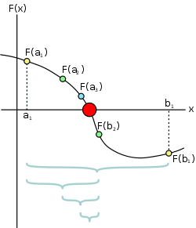
Lecture # 2, Section 2, Slide # 2.2.2
Divide and Conquer Approach
Divide the search domain and see if be resolved
Example : Bisection method; also called as Binary Search
In binary search, the numbers are in an ordered fashion

Slide 16
Lecture # 2, Section 2, Slide # 2.2.3
Iterative Methods
Iterative methods generate a sequence of solutions which are gradually improving
An iterative method should have a terminating criteria
Rate of convergence is important
Some iterative methods are using for finding the root of an equation
Iterative methods are also used for solving a set of linear equations

Slide 17
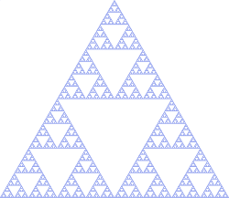
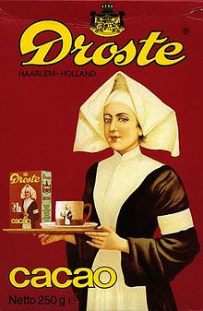
Lecture # 2, Section 2, Slide # 2.2.4
Recursive Techniques
A problem can be solved by breaking it down to a sub-problem
This process goes on till a termination situation arises
For the terminal situation, an explicit answer is available
Factorial of n is an example

Slide 18
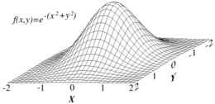
Lecture # 2, Section 2, Slide # 2.2.5
Hill Climbing Methods
Also known as steepest gradient methods
Locally find the best possible direction of search and the maximum distance along that direction
These methods are used for finding the local optimal solution

Slide 19
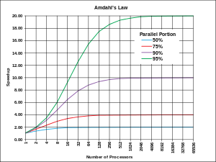
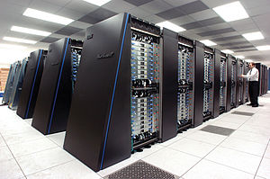
Lecture # 2, Section 2, Slide # 2.2.6
Parallel Algorithms
Large problems are divided into number of smaller problems; each small problem is solved in parallel
Many problems of HPC are dealt with in parallel fashion
Example: Find all the prime numbers between 1 and 100000 can be dealt with in parallel fashion

Slide 20
Lecture # 2, Section 2, Slide # 2.2.7
Methods of Induction
Mathematical induction is a method of mathematical proof. The first step is to prove for the base case. The second step is invoke the induction that implying that the statement is true for the next case.
Example: Sum of natural numbers from o to n.
Structural induction can be extended to other math models

Slide 21
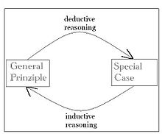
Lecture # 2, Section 2, Slide # 2.2.8
Logical Reasoning Techniques
Induction and abduction are the forms of logical reasoning. It has three elements: Deductive reasoning, Inductive reasoning and abductive reasoning.
When it rains, things outside get wet.
Mathematical logic and Philosophical logic

Slide 22
Thank You!
Visit us at www.mahindraecolecentrale.edu.in
Disclaimer
Mhindra, Ecole Centrale, herein referred to as MEC provide a wide array of presentations and reports, with the contributions of various professionals. These presentations and reports are for informational purposes and private circulation only and do not constitute an offer to buy or sell any securities mentioned therein. They do not purport to be a complete description of the markets conditions or developments referred to in the material. While utmost care has been taken in preparing the above, we claim no responsibility for their accuracy. We shall not be liable for any direct or indirect losses arising from the use thereof and the viewers are requested to use the information contained herein at their own risk. These presentations and reports should not be reproduced, re-circulated, published in any media, website or otherwise, in any form or manner, in part or as a whole, without the express consent in writing of MEC or its subsidiaries. Any unauthorized use, disclosure or public dissemination of information contained herein is prohibited. Unless specifically noted, MEC is not responsible for the content of these presentations and/or the opinions of the presenters. Individual situations and local practices and standards may vary, so viewers and others utilizing information contained within a presentation are free to adopt differing standards and approaches as they see fit. You may not repackage or sell the presentation. Products and names mentioned in materials or presentations are the property of their respective owners and the mention of them does not constitute an endorsement by MEC. Information contained in a presentation hosted or promoted by MEC is provided “as is” without warranty of any kind, either expressed or implied, including any warranty of merchantability or fitness for a particular purpose. MEC assumes no liability or responsibility for the contents of a presentation or the opinions expressed by the presenters. All expressions of opinion are subject to change without notice.
Copyright © 2012 Mahindra Satyam. All rights reserved.

