Slide 1
CS 101 Introduction to Computing
Semester – 2014 -15 / II Semester
Units – 2 – 0 – 2 – 3
Pre-requisite – None
Instructors – Sanjay Dhande, Arya Bhattacharyya, Lilian Besson, Vipin K
Tutors – Arya, Lilian, Vipin, Vivek, Kondiah

Slide 2
Lecture # 1, Section 1, Slide # 1.1.1
Course Organization
Time Table: Lectures – Mondays, Tuesdays
Time Table: Lab Sessions – Mondays, Tuesdays
Lab Assignments – 12, Lab Sessions - 15
One Term Paper
Homework Assignments – 10, Lectures - 30
Two Mid-semester Tests, End-semester Exam
Attendance – Absolutely compulsory
Honors Code applies in the course

Slide 3
Lecture # 1, Section 1, Slide # 1.1.2
Time Table - Lectures
For A Section:
Monday 10:35 – 11:30 LT - 2
Tuesday 08:25 – 09:20 LT - 2
For B Section:
Monday 08:25 – 09:20 LT - 4
Tuesday 11:35 – 12:30 LT - 2
Special Schedule To be announced as needed

Slide 4
Lecture # 1, Section 1, Slide # 1.1.3
Time Table – Lab Sessions
For A Section:
Sub-section A-1 Tue 13:35 – 15:30
Sub-section A-2 Fri 15:35 – 17:30
Sub-section A-3 Mon 14:35 – 16:30
Sub-section A-4 Wed 10:35 – 12:30
For B Section:
Sub-section B-1 Mon 10:35 – 12:30
Sub-section B-2 Fri 13:35 – 15:30
Sub-section B-3 Wed 08:25 – 10:20
Sub-section B-4 Thu 08:25 – 10:20

Slide 5
Lecture # 1, Section 1, Slide # 1.1.4
Lab Assignments
There shall be 12 lab assignments
Lab assignments will be announced in advance
Students are required to work on the lab assignments before coming to the lab
Students are required to finish the program during the lab hours with good points
Those who will not; will be given one extra day with penalty
Each lab will carry 2 points
Honors code is strictly applicable for lab work

Slide 6
Lecture # 1, Section 1, Slide # 1.1.5
Term Paper
Students will be required to submit one term paper
This will be towards the end of the semester
The term paper will be submitted and presented by each group
Each group will consist of two students
The term paper will involve writing of a large program in Python language
Each group will submit the title of the term paper in advance
Honors Code applies in the term paper

Slide 7
Lecture # 1, Section 1, Slide # 1.1.6
Homework Assignments
The course will have a total of 10 homework assignments
Questions of homework will reflect the nature of questions in the mid-sem tests and end-sem exam
Approximately one week time will be given for completing the homework assignment
Each assignment will carry 1 point
Homework has to be submitted at the time of lab
Honors Code applies for the homework assignments

Slide 8
Lecture # 1, Section 1, Slide # 1.1.7
Two Mid-semester Tests
There shall be two mid-semester tests
Each test will be of 90 minute duration
Each test will cover about 5 – 6 weeks of course material
Each test will carry 15 points
Attendance – Absolutely compulsory
Honors Code applies in the tests

Slide 9
Lecture # 1, Section 1, Slide # 1.1.8
The End-semester Examination
There shall be one end-sem examination at the end of the semester
It shall be of duration 180 minutes
It shall be a closed-book, closed-notes examination
The exam will be based on the
Two Mid-semester Tests, End-semester Exam
Attendance – Absolutely compulsory
Honors Code applies in the course

Slide 10
Lecture # 1, Section 1, Slide # 1.1.9
The Weights
First Mid-sem Test – 15%
Second Mid-sem Test – 15%
End-sem Examination – 30%
Lab Work (12 x 2) - 24%
Term Paper - 6%
Homework (10 x 1) – 10%
Total - 100%
Honors Code applies in the course

Slide 11
Lecture # 1, Section 1, Slide # 1.1.10
Text Book & Reference Books
Time Table: Lab Sessions – Mondays, Tuesdays
Lab Assignments – 15, Lab Sessions - 15
One Term Paper
Homework Assignments – 10, Lectures - 30
Two Mid-semester Tests, End-semester Exam
Attendance – Absolutely compulsory
Honors Code applies in the course

Slide 12
Lecture # 1, Section 1, Slide # 1.1.11
The Honor’s Code
Time Table: Lectures – Mondays, Tuesdays
Time Table: Lab Sessions – Mondays, Tuesdays
Lab Assignments – 15, Lab Sessions - 15
One Term Paper
Homework Assignments – 10, Lectures - 30
Two Mid-semester Tests, End-semester Exam
Attendance – Absolutely compulsory
Honors Code applies in the course

Slide 13
Lecture # 1, Section 1, Slide # 1.1.12
Attendance Policy
Time Table: Lectures – Mondays, Tuesdays
Time Table: Lab Sessions – Mondays, Tuesdays
Lab Assignments – 15, Lab Sessions - 15
One Term Paper
Homework Assignments – 10, Lectures - 30
Two Mid-semester Tests, End-semester Exam
Attendance – Absolutely compulsory
Honors Code applies in the course

Slide 14
Thank You!
Visit us at www.mahindraecolecentrale.edu.in
Disclaimer
Mhindra, Ecole Centrale, herein referred to as MEC provide a wide array of presentations and reports, with the contributions of various professionals. These presentations and reports are for informational purposes and private circulation only and do not constitute an offer to buy or sell any securities mentioned therein. They do not purport to be a complete description of the markets conditions or developments referred to in the material. While utmost care has been taken in preparing the above, we claim no responsibility for their accuracy. We shall not be liable for any direct or indirect losses arising from the use thereof and the viewers are requested to use the information contained herein at their own risk. These presentations and reports should not be reproduced, re-circulated, published in any media, website or otherwise, in any form or manner, in part or as a whole, without the express consent in writing of MEC or its subsidiaries. Any unauthorized use, disclosure or public dissemination of information contained herein is prohibited. Unless specifically noted, MEC is not responsible for the content of these presentations and/or the opinions of the presenters. Individual situations and local practices and standards may vary, so viewers and others utilizing information contained within a presentation are free to adopt differing standards and approaches as they see fit. You may not repackage or sell the presentation. Products and names mentioned in materials or presentations are the property of their respective owners and the mention of them does not constitute an endorsement by MEC. Information contained in a presentation hosted or promoted by MEC is provided “as is” without warranty of any kind, either expressed or implied, including any warranty of merchantability or fitness for a particular purpose. MEC assumes no liability or responsibility for the contents of a presentation or the opinions expressed by the presenters. All expressions of opinion are subject to change without notice.
Copyright © 2012 Mahindra Satyam. All rights reserved.

Slide 15
Lecture # 1, Section 2, Slide # 1. 2.1
Historical Machines of Computing
Historical Machines of Computing
Analytical Engine
Difference Engine
Jacquard Loom, Knitting Machine
Slide Rule, Logarithmic Tables
Calculators
Unit Record Machines
ELIAC, UNIVAC computers

Slide 16
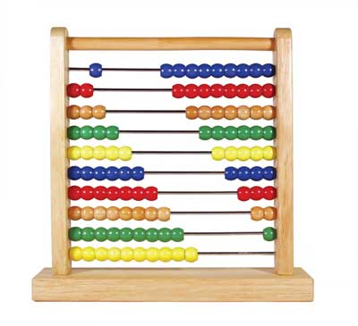
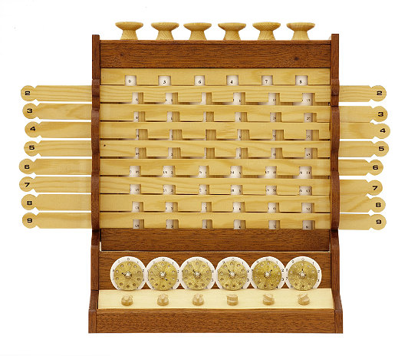
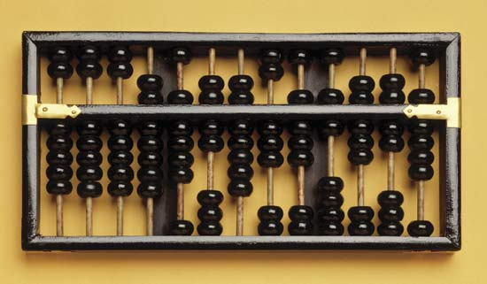
Lecture # 1, Section 2, Slide # 1. 2.2
Abacus and other Devices

Slide 17
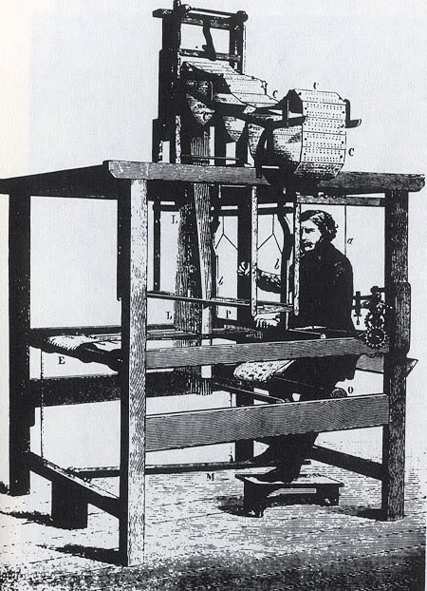
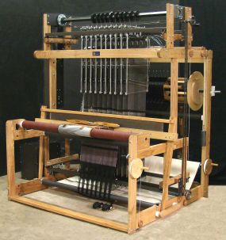
Lecture # 1, Section 2, Slide # 1.2.3
Jacquard Loom, Knitting Machine, Music Organ, Doll

Slide 18
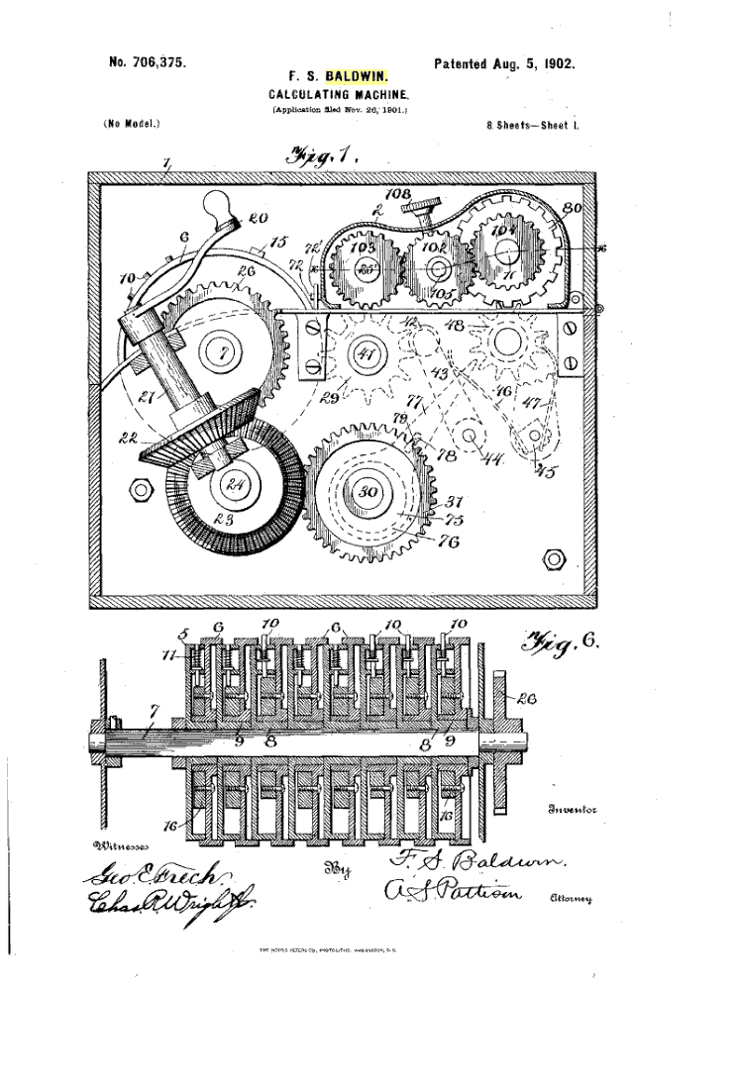
Lecture # 1, Section 2, Slide # 1.2.4
Difference Engine

Slide 19
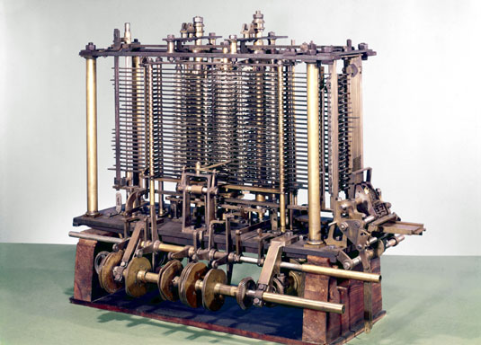
Lecture # 1, Section 2, Slide # 1.2.5
Analytical Engine

Slide 20
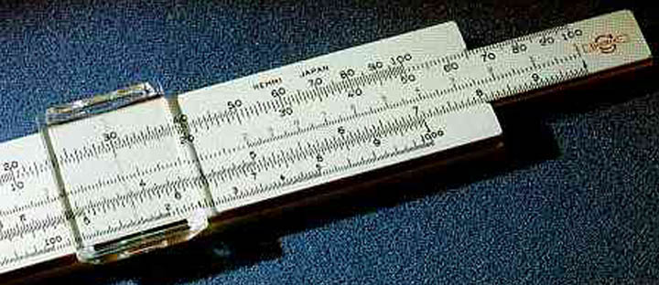
Lecture # 1, Section 2, Slide # 1.2.6
Slide Rule, Log Tables

Slide 21
Lecture # 1, Section 2, Slide # 1.2.7
Calculators

Slide 22
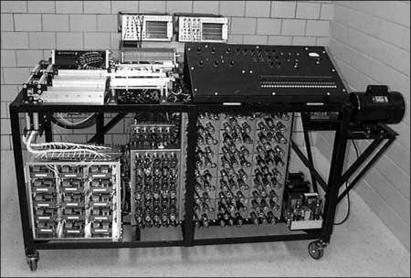
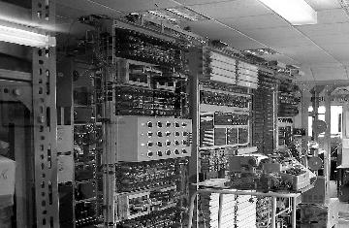
Lecture # 1, Section 2, Slide # 1.2.8
Unit Record Machines

Slide 23
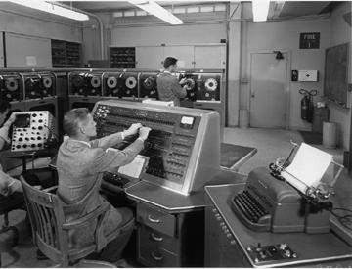
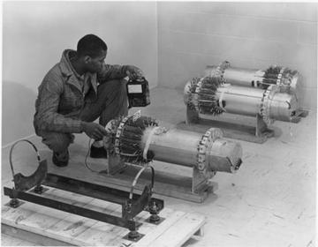
Lecture # 1, Section 2, Slide # 1.2.9
ELIAC, UNIVAC Computers

Slide 24
