Slide 1
Présentation / Titre

Slide 2
Problématique du champ magnétique dans les étoiles

Slide 3
Problématique (suite)

Slide 4
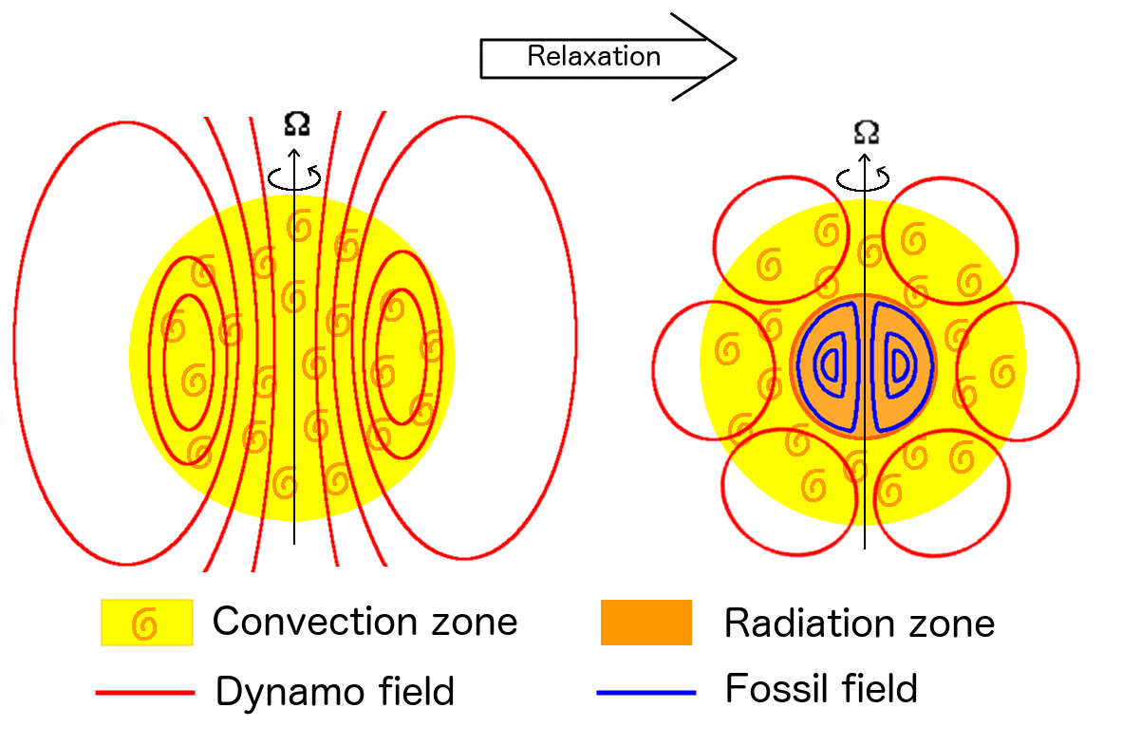
Relaxation

Slide 5
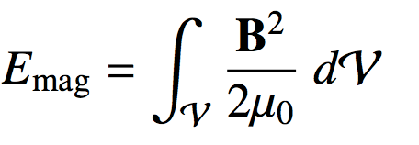
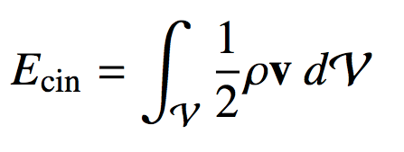
Relaxation
Energies :

Slide 6
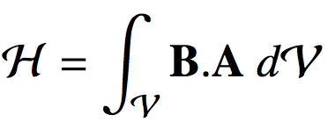
Relaxation
Energies :
Invariants :

Slide 7
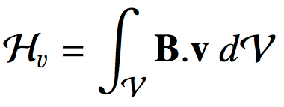
Relaxation
Energies :
Invariants :

Slide 8
Relaxation
Energies :
Invariants :

Slide 9
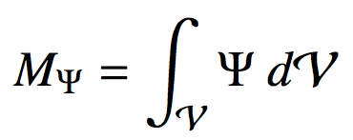
Relaxation
Energies :
Invariants :

Slide 10
Relaxation
Energies :
Invariants :

Slide 11
Variational principle

Slide 12
Variational principle

Slide 13
Variational principle
Système

Slide 14
Variational principle
Système

Slide 15
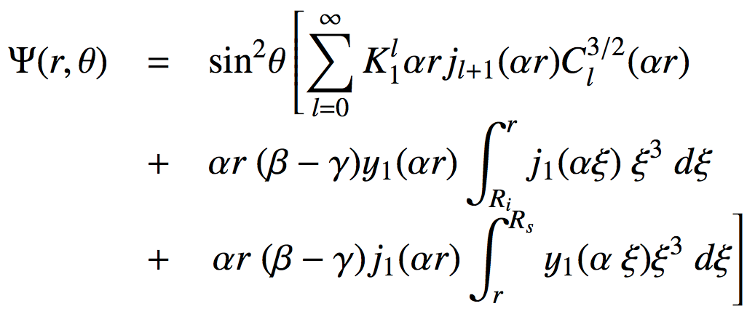
Solution

Slide 16
Solution
a, b, g,
?

Slide 17
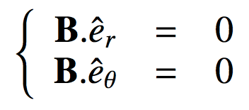
Conditions
Boundary conditions :

Slide 18
Conditions
Boundary conditions :
a,

Slide 19
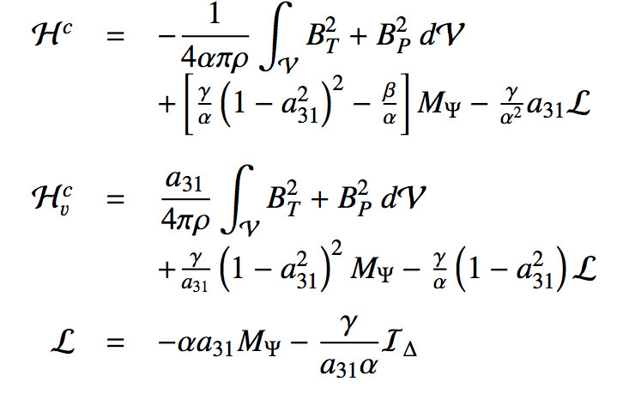
Conditions
Boundary conditions :
a,
Initial conditions :

Slide 20
Conditions
Boundary conditions :
a,
Initial conditions :
b, g,

Slide 21
Full Solution

Slide 22
Links between helicities and energies

Slide 23
Velocity field profile

Slide 24
Velocity field profile

Slide 25
Velocity field profile
Solid rotation

Slide 26
Velocity field profile
Aligned with magnetic field

Slide 27
Velocity field profile

Slide 28
Conclusion

