Slide 1


Chromocenters establishment
in response to light
during early-developemental steps in Arabidopsis
September 28th 2012

Slide 2
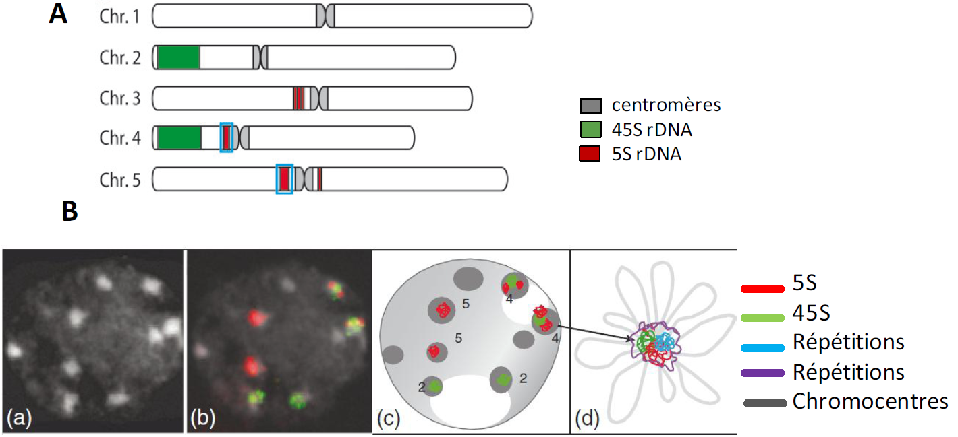
Chromosome organization in Arabidopsis nuclei
Fransz et al., 2011

Slide 3
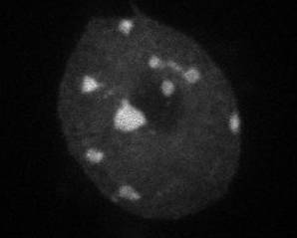
Chromosome organization in Arabidopsis nuclei
Relative Heterochromatin Fraction :
RHF = signal chromocentres / signal nucléaire
DAPI
COTYLEDONS

Slide 4
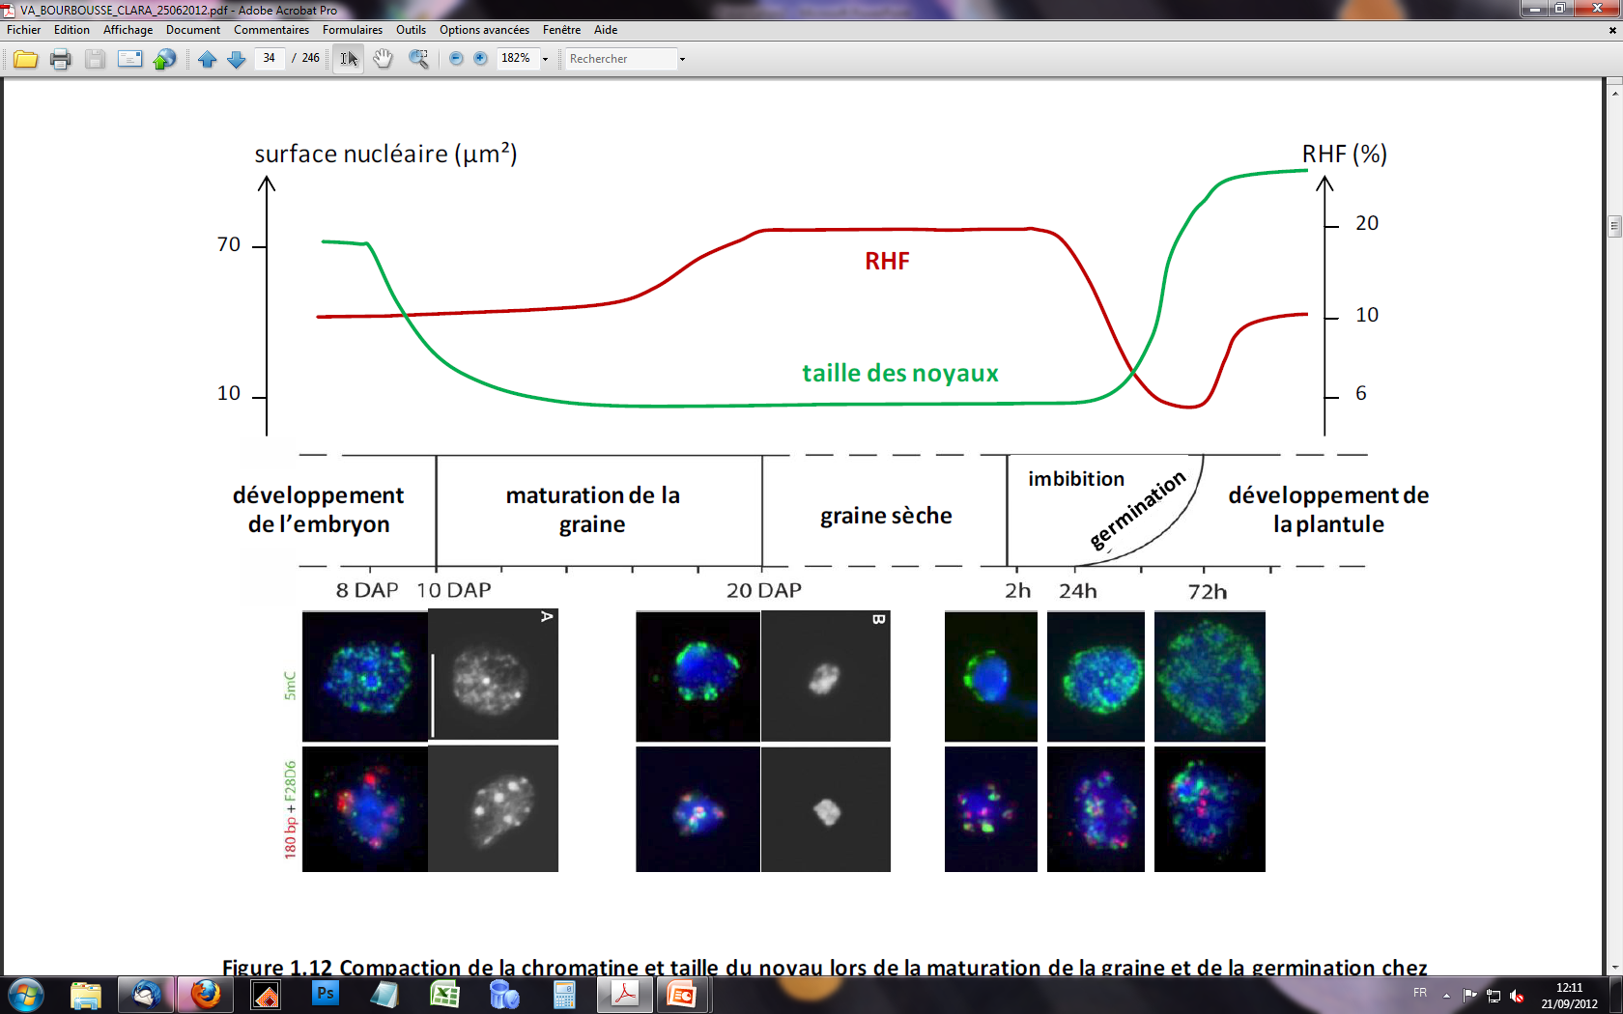
Chromocenter establishment upon germination
5meC
180pb
Pericentric
Van Zanten et al., 2011

Slide 5
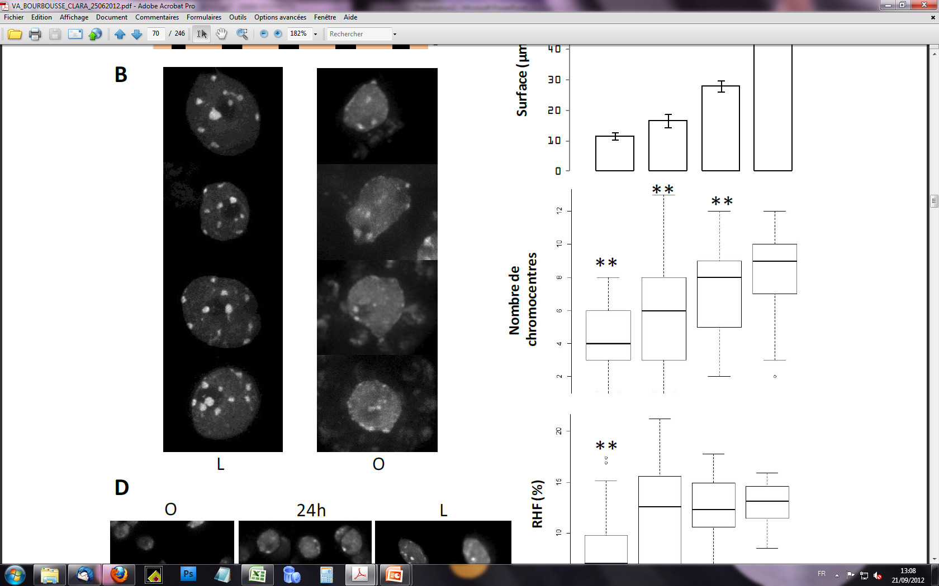
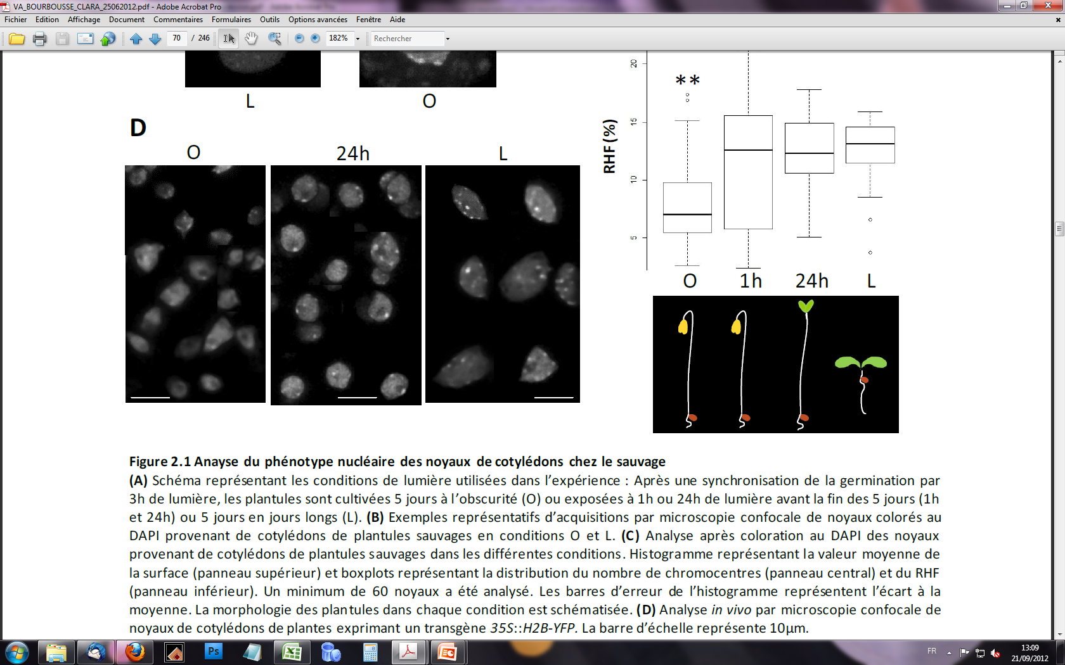
Drastically different chromocenter organization of nuclei
from photomorphogenic and skotomorphogenic cotyledons
LIGHT
5-day old seedlings
DARK

Slide 6
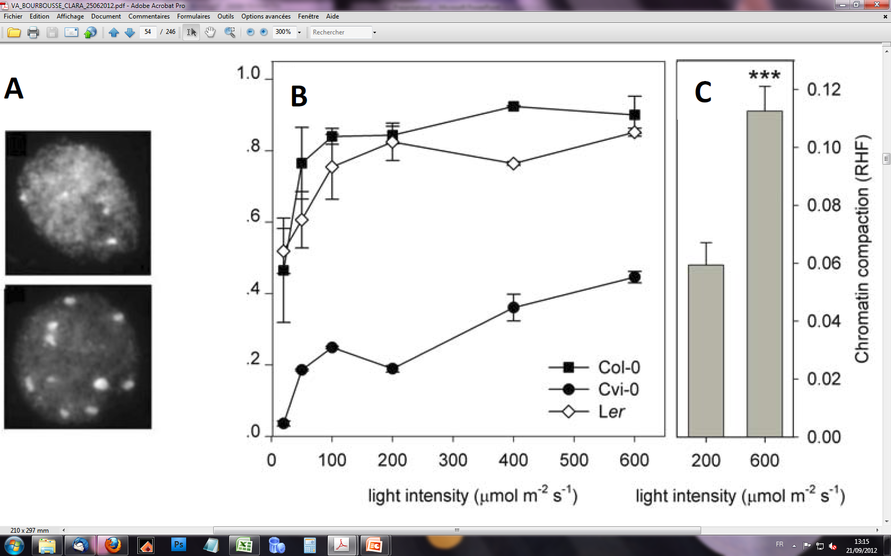
Light intensity has been shown to influence chromatin compaction
Low light
High light
CRY2
PHYB
Light intensity (µmol.m-2.s-1)
Tessadori et al., 2009
Van Zanten et al., 2010

Slide 7
1. Comparison of chromatin compaction in skotomorphogenic and photomorphogenic cotyledons.
2. Characterisation of chromatin dynamics during the photomorphogenic developmental transition in cotyledons nuclei.
3. Characterisation of chromatin dynamics during the photomorphogenic developmental transition in hypocotyls nuclei.
4. Characterisation of involved light signalling pathways.
5. Search for specific chromatin features associated to the heterochromatin profile in etiolated nuclei.
6. Comparison of the establishment of chromocenters between seedlings germinated in darkness and in light.

Slide 8
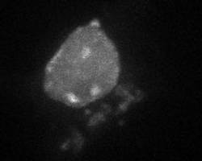
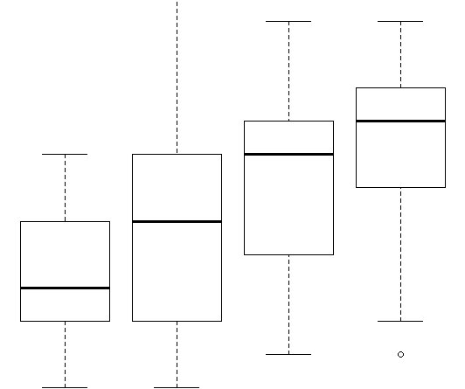
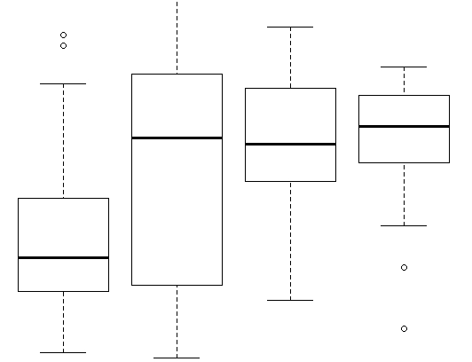
Comparison of chromatin compaction
in skotomorphogenic and photomorphogenic cotyledons.
Area (µm²)
Dark Light
**
**
10
CC
6
2
15
RHF calculation shows that chromatin compaction is lower in skotomorphogenic cotyledons.
RHF (%)
10
5
O
1h
24h
L

Slide 9



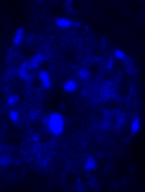
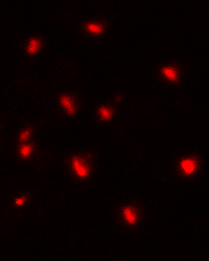
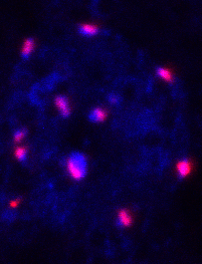
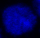
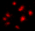
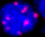
Comparison of chromatin compaction
in skotomorphogenic and photomorphogenic cotyledons.
DAPI
180bp
merge
DAPI
180bp
merge
RHF indicates that chromatin compaction is low in skotomorphogenic cotyledons.
But centromeric repeats localization shows clear compacted spot in the absence of CC.
The whole chromatin is more compacted ?
Decompaction of pericentric repeats could lead to the absence of visible CC ?
4µm

Slide 10
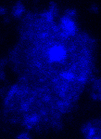
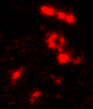
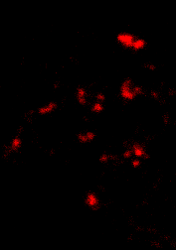
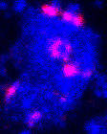
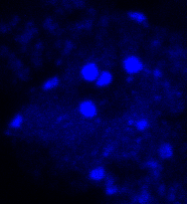
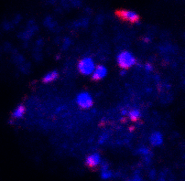
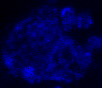
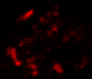
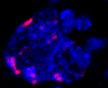
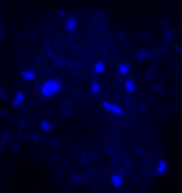
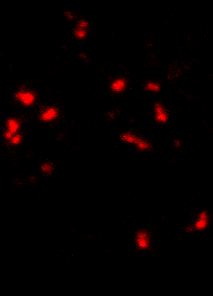
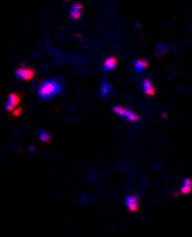
Comparison of chromatin compaction
in skotomorphogenic and photomorphogenic cotyledons.
Pericentric
repeats
Pericentric
repeats
DAPI
merge
DAPI
merge
4µm

Slide 11
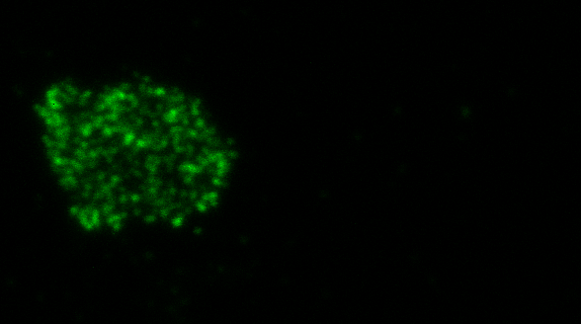
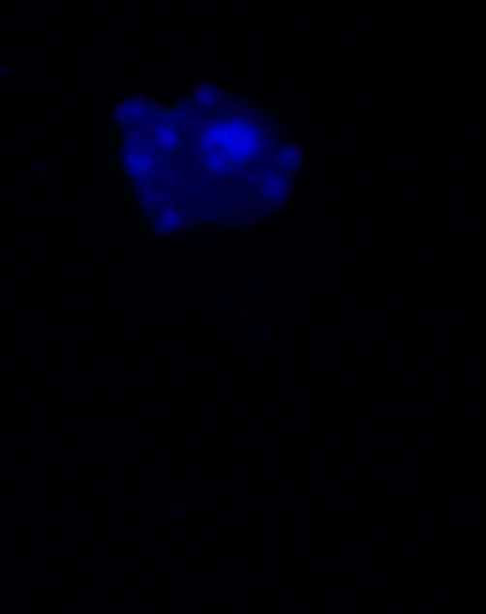
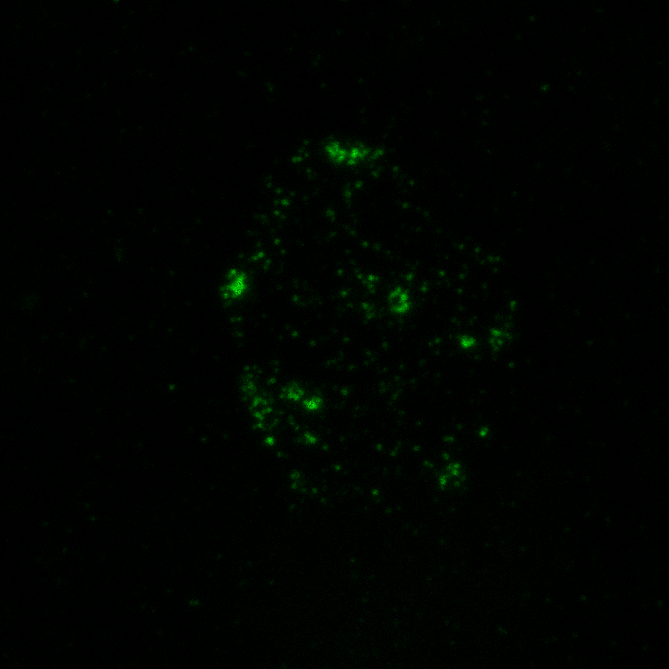
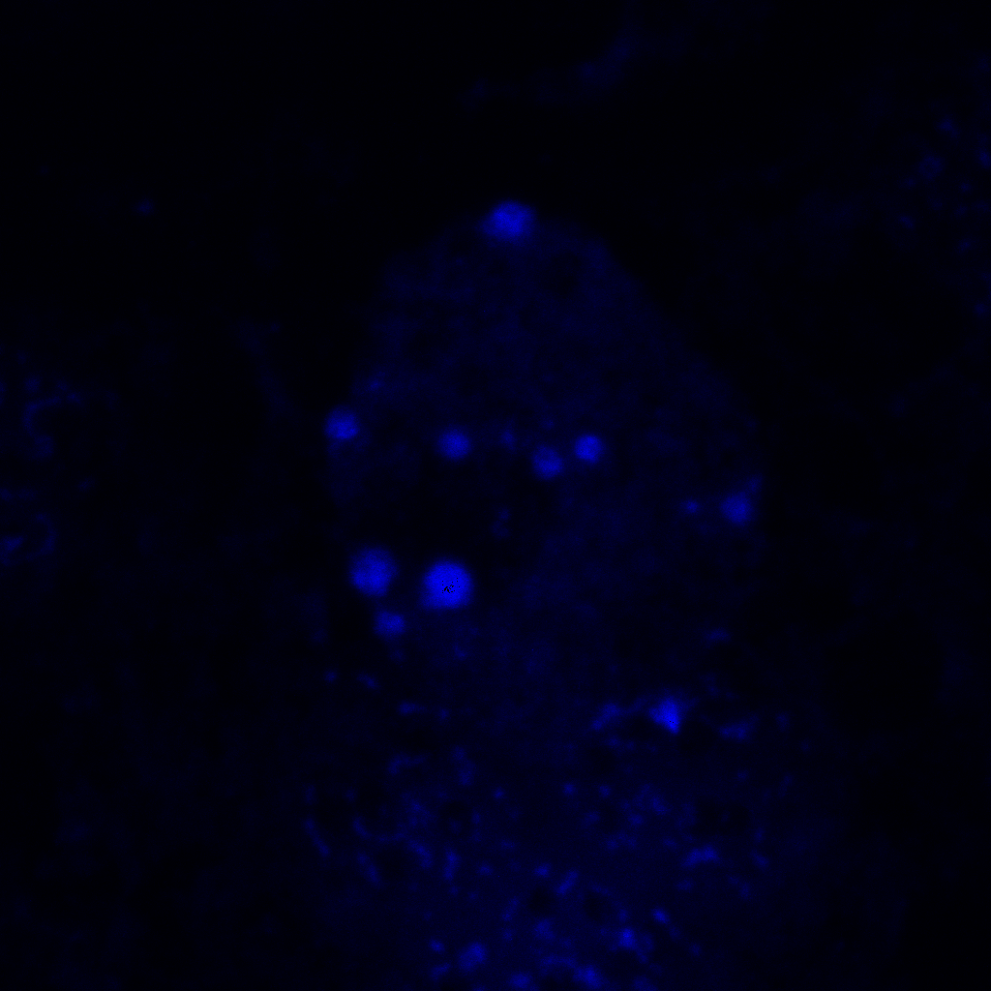
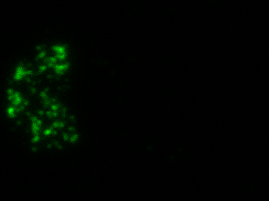
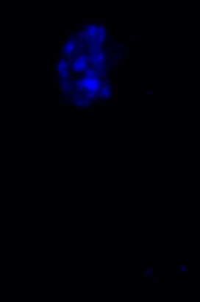
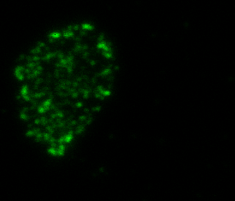
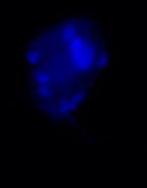
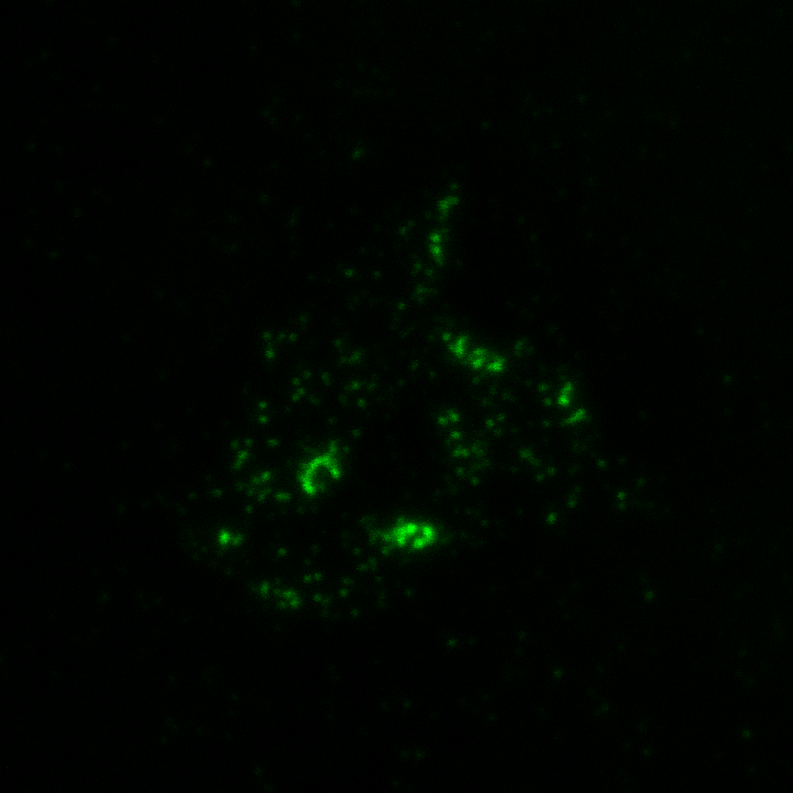
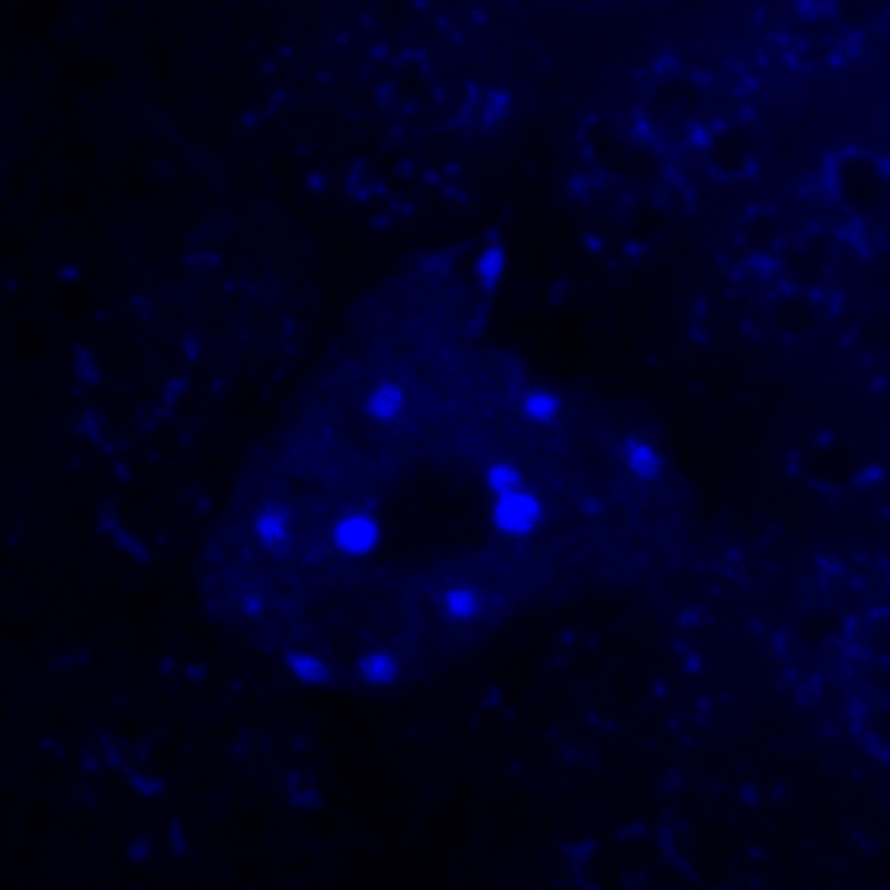
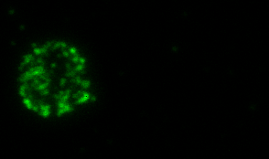
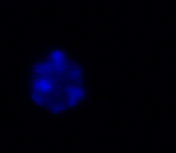
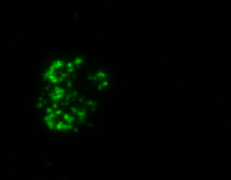
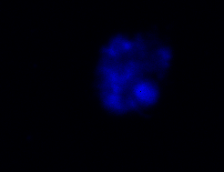
Comparison of chromatin compaction
in skotomorphogenic and photomorphogenic cotyledons.
5meC
DAPI
5meC
DAPI
4µm

Slide 12
Comparison of chromatin compaction
in skotomorphogenic and photomorphogenic cotyledons.
FISH with pericentromeric probes and 5meC immunodetection confirm the decompacted state of chromatin in skotomorphogenic cotyledons.
FISH with centromeric probes indicate that centromeres are well compacted.

Slide 13
Comparison of chromatin compaction
in skotomorphogenic and photomorphogenic cotyledons.
Light
Dark
centromeric
centromeric
hyp1:
Euchromatin more compacted
Pericentric repeats decompacted
=> CC not visible
hyp2:
Euchromatin decompacted as in light
Centromeric repeats less compacted
Pericentric repeats decompacted
=> CC not visible
pericentric
pericentric

Slide 14
2. characterisation of chromatin dynamics during the photomorphogenic developmental transition
Area (µm²)
Dark Light
**
**
10
CC
6
2
15
The photomorphogenic transition is associated to chromocenters formation in cotyledons.
RHF (%)
10
5
O
1h
24h
L

Slide 15
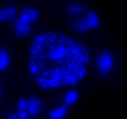
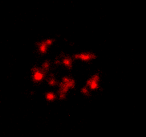
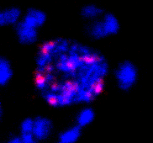
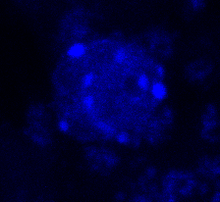
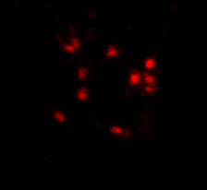
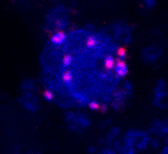
2. characterisation of chromatin dynamics during the photomorphogenic developmental transition
Pericentric
repeats
DAPI
merge
Dark
3h
24h

Slide 16
2. Characterisation of chromatin dynamics during the photomorphogenic developmental transition
Pericentric
repeats
DAPI
merge
FISH with pericentromeric probes confirm the progressive compaction of chromatin during photomorphogenesis.
What happens in hypocotyls ?

Slide 17
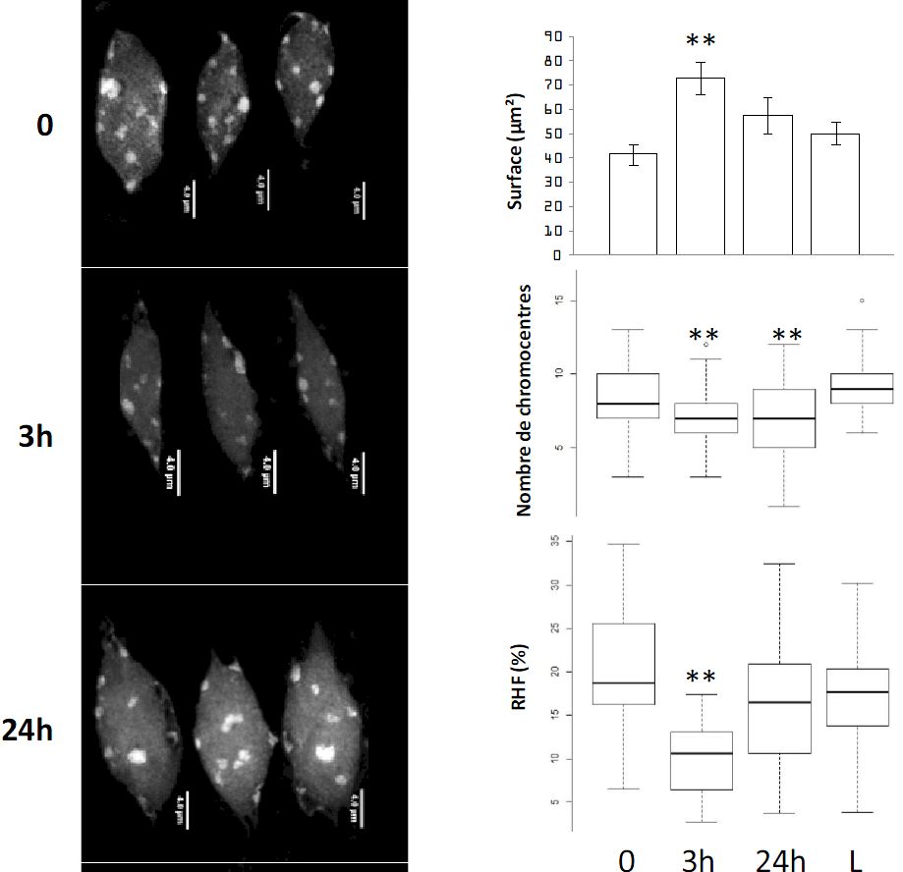
3. characterisation of chromatin dynamics during
the photomorphogenic developmental transition in hypocotyls nuclei.
Pericentric
repeats
DAPI

Slide 18
3. characterisation of chromatin dynamics during
the photomorphogenic developmental transition in hypocotyls nuclei.
But, in a second independant experiment :
RHF
0 3h 24h

Slide 19
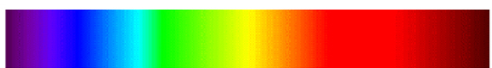
4. Characterisation of chromatin dynamics during the photomorphogenic developmental transition
Pericentric
repeats
DAPI
merge
Which light signalling pathways are involved
in the CC establishment upon light exposure ?
Low light
"high" light
CRY2
PHYB
UVR8
ZTL
cry1, cry2
phot1, phot2
phyB
C, D, E
phyA
not involved in photomorphogenesis

Slide 20
4. characterisation of involved light signalling pathways.
merge
Observation of nuclei after 24h of white light in cotyledons from photoreceptor mutants
DARK
Pericentric
repeats
DAPI
+24h L
DARK
+24h L
DAPI
**
**
**
**
**
area (µm²)
Area (µm²)
CC

Slide 21
4. characterisation of involved light signalling pathways.
24h Red (30µmol.m-2.s-1)
24h Far red (5µmol.m-2.s-1)
24h Blue (25µmol.m-2.s-1)
**
**
**
wt phyb wt phya wt cry1cry2
wt phyb wt phya wt cry1cry2
area (µm²)
CC

Slide 22
4. characterisation of involved light signalling pathways.
Pericentric
repeats
DAPI
merge
Nuclear size :
No effect of photoreceptor mutations under white light.
Under monochromatic light: blue light, and to a lesser extent red light, are involved.
CC number:
Only cry1cry2 mutants has less CC than wt under white light.
Only blue light triggers the formation of CC as white light.

Slide 23
5. Search for specific chromatin features
associated to the heterochromatin profile in etiolated nuclei.
Pericentric
repeats
DAPI
merge
Chromatin decompaction can be associated to:
TE reactivation
loss of DNA methylation
loss of H3K9me2
loss of nucleosome occupancy

Slide 24
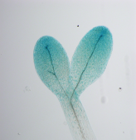



5. Search for specific chromatin features
associated to the heterochromatin profile in etiolated nuclei.
Pericentric
repeats
DAPI
merge
0
24h
L
LTR GP1
GUS
TGS
Test histochimique GUS

Slide 25
5. Search for specific chromatin features
associated to the heterochromatin profile in etiolated nuclei.
Pericentric
repeats
DAPI
merge
GUS relative expression
% of expression
GUS expression prior to 5 days ?
During early steps of germination ?

Slide 26
5. Search for specific chromatin features
associated to the heterochromatin profile in etiolated nuclei.
Pericentric
repeats
DAPI
merge
2h
24h
48h
72h

Slide 27
5. Search for specific chromatin features
associated to the heterochromatin profile in etiolated nuclei.
Pericentric
repeats
DAPI
merge
RT-qPCR:
SSIII with random hexamers and oligodT
+ and – RT.
% _{expression +RT} - % _{expression -RT}

Slide 28

5. Search for specific chromatin features
associated to the heterochromatin profile in etiolated nuclei.
Pericentric
repeats
DAPI
merge
McrBC-qPCR
McrBC-PCR
Bisulfite sequencing

Slide 29
5. Search for specific chromatin features
associated to the heterochromatin profile in etiolated nuclei.
Pericentric
repeats
DAPI
merge
No loss of DNA methylation has been detected in skotomorphogenic cotyledons.
H3K9me2 enrichment could be tested by IF and ChIP.

Slide 30
5. Search for specific chromatin features
associated to the heterochromatin profile in etiolated nuclei.
Pericentric
repeats
DAPI
ChIP anti-H3
merge
% input
Normalised aginst controls
Control genes
UP
DOWN
TE
% input
Normalised aginst controls
centromeric
45S rRNA (telomeric)

Slide 31
6. Comparison of the establishment of chromocenters
between seedlings germinated in darkness and in light.
5meC
180pb
Pericentric
Van Zanten et al., 2011

Slide 32






6. Comparison of the establishment of chromocenters
between seedlings germinated in darkness and in light.
Pericentric
repeats
DAPI
merge
24h
48h
72h
LIGHT
4µm
DARK

Slide 33
6. Comparison of the establishment of chromocenters
between seedlings germinated in darkness and in light.
Pericentric
repeats
DAPI
merge
Area (µm²)

Slide 34

6. Comparison of the establishment of chromocenters
between seedlings germinated in darkness and in light.
Pericentric
repeats
DAPI
Pericentric
repeats
merge
DAPI
merge
100µm
2h
100µm
24h
48h
72h

Slide 35
6. Comparison of the establishment of chromocenters
between seedlings germinated in darkness and in light.
3 days
5 days
72h

Slide 36
6. Comparison of the establishment of chromocenters
between seedlings germinated in darkness and in light.
Pericentric
repeats
DAPI
merge
other CC
establishment
only under light
Light
CC 45S
establishment
Dark

Slide 37

6. Comparison of the establishment of chromocenters
between seedlings germinated in darkness and in light.
Pericentric
repeats
DAPI
merge

